Slide 1
Graphs

Slide 2
Introduction
A data structure that consists of a set of nodes (vertices) and a set of edges that
connect the nodes to each other
Formal Definition:
A graph G is a collection of two sets V and E represented as G(V, E) where,
V – Collection of vertices represented as V(G) = V_{0,} V_{1,} V_{2,} V₃ ……… V_{n-1}
E – Collection of edges represented as E(G) = E_{1,} E_{2,} E₃ ……… E_{n}
Each edge is a tuple (V_{x}, V_{y}), where V_{x}, V_{y} in V

Slide 3
Types of graph
Undirected Graph
A graph which has unordered pair of vertices
If there is any edge between Vx to Vy then it can be represented (V_{x}, V_{y} ) or (V_{y}, V_{x} )
Let a graph G(V, E) where,
V(G) = {1,2,3,4,5}
E(G) = {(1,2), (1,3), (1,5), (2,5), (3,4), (4,5)}
1
2
4
3
5

Slide 4
Types of graph (Cont…)
2. Directed Graph
A graph which has ordered pair of vertices
If there is any edge between Vx to Vy then it can be presented only (V_{x}, V_{y} )
Let a graph G(V, E) where,
V(G) = {1,2,3,4,5}
E(G) = {(1,2), (1,5),(2,1), (2,4), (3,1), (3,4), (5,4)}
1
2
4
3
5

Slide 5
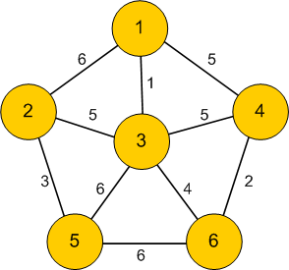
Terminology (Contd…)
1. Weighted Graph: a graph in which each branch is given a numerical weight.
2. Adjacent nodes: Two vertices are called adjacent if they share a common edge.
Eg.
Nodes 4 and 6 are adjacent
Nodes 1 and 5 are not adjacent

Slide 6
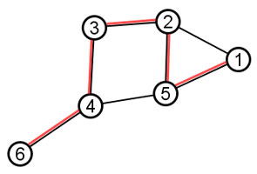
Terminology (Contd…)
4. Path: A way to reach the destination node from an origin node by traversing edges in the graph.
For example, One path from node 6 to 1 is highlighted with red in below graph:
A path P is represented as ordered list of directed edges as follows :
P = ((v₁,v₂),(v₂,v₃),...,(v_{k},v_{k+1})).
The first vertex of the first edge of a path is the origin and the second vertex of the last edge is the destination.
5. Length of path: The length of a path is the number of edges that it uses.
e.g. the length of the red path above is 5.

Slide 7
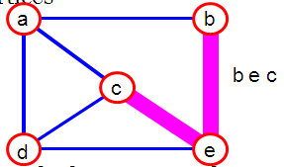
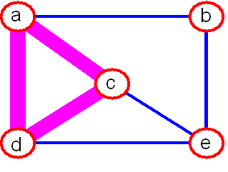
Terminology (Contd…)
6. Simple path : A path that does not repeat the vertices is called a simple path.
7. Cycle : Path in which the initial vertex of the path is also the terminal (end) vertex of the path.
Fig: bec is Simple graph
Fig: acda is Cycle

Slide 8
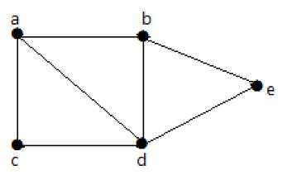
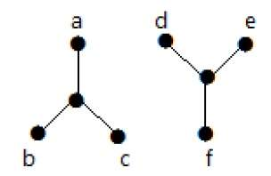
Terminology (Contd…)
Connected graph: A graph is said to be connected if there is a path between every pair of vertex.
From every vertex to any other vertex, there should be some path to traverse.
connected
not connected

Slide 9
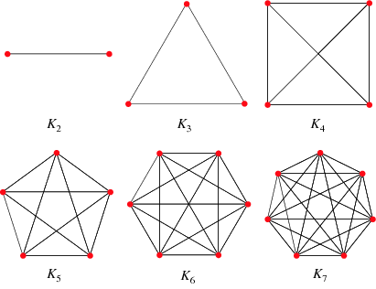
Complete Graph
Complete graph: A graph in which every pair of vertices is connected by an edge.
The complete graph with n vertices is denoted by Kn.

Slide 10
Representation of graph
To represent graph in computer memory –
Adjacency matrix
Adjacency list

Slide 11
Adjacency matrix
Graph is represented using matrix (2D array)
Matrix keeps the information about the adjacent nodes for each node
If node is adjacent then put 1 at (i,j) location otherwise put 0
i.e. Mat[i][j] = 1 if there is an edge from node i to j
= 0 if there is no edge from node i to j
If graph is weighted graph then adjacency matrix will contain following –
Mat[i][j] = weight on edge if there is an edge from node i to j
= 0 if there is no edge from node i to j

Slide 12
Adjacency matrix (cont…)
A B C D E
A
C
A B C D E
0 | 0 | 1 | 0 | 1
1 | 0 | 1 | 0 | 0
0 | 0 | 0 | 0 | 1
0 | 0 | 1 | 0 | 0
0 | 1 | 0 | 1 | 0
D
B
E
A
A B C D E
A B C D E
0 | 1 | 1 | 1 | 0
1 | 0 | 0 | 1 | 0
1 | 0 | 0 | 1 | 1
1 | 1 | 1 | 0 | 0
0 | 0 | 1 | 0 | 0
C
D
B
E

Slide 13
Adjacency matrix (cont…)
A B C D E
A
3
C
2
A B C D E
0 | 0 | 3 | 0 | 3
1 | 0 | 4 | 0 | 0
0 | 0 | 0 | 0 | 8
0 | 0 | 2 | 0 | 0
0 | 7 | 0 | 5 | 0
1
8
D
4
3
5
B
E
7
Memory required to store graph G(V,E) using adjacency matrix is
O(V²)

Slide 14
Adjacency matrix
Pros:
1. Representation is easier to implement and follow.
2. Removing an edge takes O(1) time. Queries like whether there is an edge from vertex ‘u’ to vertex ‘v’ are efficient and can be done O(1).
3. It is fast to add a new edge O(1)
Cons:
1. Consumes more space O(V²).
2. Even if the graph is sparse(contains less number of edges), it consumes the same space.
3. It is slow to add/delete a node and takes O(V²) time.

Slide 15
Adjacency List
Graph is represented using linked list
List keeps the information about edges
One adjacency list is used per vertex.
Pros:
1. Less memory requirement than adjacency matrix, Memory usage depends on the number of edges (not number of nodes). Therefore, it can save a lot of memory if the graph has less number of edges.
2. It is fast to add/delete a node; easier than the matrix representation
Cons:
1. Finding the presence or absence of specific edge between any two nodes is slightly slower.

Slide 16
Adjacency List (cont…)
A
E
C
A
C
D
B
A
C
B
E
E
C
struct Hnode{
int INFO;
struct Hnode *LINK;
struct Node *ALINK;
};
D
C
E
D
B
If graph is directed then adjacent list structure –
struct Node{
int AINFO; // AINFO stores value of vertex
struct Node *Next;
};

Slide 17
Adjacency List (cont…)
A
E 3
C 3
A
3
C
2
D
B
A 1
C 4
1
8
4
3
5
B
E
E 8
7
C
D
C 2
E
D 5
B 7
If graph is weighted graph then adjacent list structure –
struct Node{
int AINFO; // AINFO stores value of vertex
int weight; // ‘weight’ stores weight of edge
struct Node *link;
} ;

Slide 18
Operations on graph
Searching
Insertion
Deletion
Traversing
Sorting

Slide 19
Adjacency list structure
Structures of nodes and header nodes –
struct Node{
int AINFO;
struct Node *Next;
};
struct Hnode{ // structure for header node
int INFO;
struct Hnode *LINK;
struct Node *ALINK;
};
Hnode *Graph_start;

Slide 20
Searching
Node Searching –
Algorithm Node_search(Graph_start, Item): This algorithm finds the location of Item(vertex) in a Graph pointed by Graph_start. It returns the LOC (location of vertex) if found.
Struct Hnode* LOC = NULL
Hnode Temp
Temp = Graph_start
While Temp != NULL
If Temp->INFO = = Item
Set LOC = Temp
Return LOC
Temp = Temp->LINK
Return LOC
struct Hnode{
int INFO;
struct Hnode *LINK;
struct Node *ALINK;
};

Slide 21
Searching (Cont…)
Edge Searching –
Algorithm Edge_search(Graph_start, src, dst): This algorithm finds the location of destination (dst) in Graph pointed by Graph_start. It returns the LOC (location of destination vertex) if found.
Struct Node* LOC = NULL
Struct Node* Atemp
Struct Hnode *LocSrc, *LocDst
LocSrc = Node_search(Graph_start, src)
LocDst = Node_search(Graph_start, dst)
If LocSrc == NULL OR LocDst == NULL
Retrun LOC
Else
ATemp = LocSrc ->ALINK
While Atemp!=NULL
If ATemp->AINFO = = dst
Set LOC = ATemp
Return LOC
ATemp = ATemp->NEXT
Return LOC
struct Node{
int AINFO;
struct Node *Next;
};
struct Hnode{
int INFO;
struct Hnode *LINK;
struct Node *ALINK;
};

Slide 22
Insertion
Node Insertion –
Algorithm Insert_Node(Graph_start, Item): This algorithm inserts the node Item in graph.
Struct Hnode *New_node, *Temp1
New_node = Allocate memory
New_node ->INFO = Item
New_node ->LINK = NULL
New_node ->ALINK = NULL
Temp1 = Graph_start
If(Graph_start ==NULL) //Empty Graph
Graph_start= New_node
Else
While (Temp1->LINK != NULL)
Temp1= Temp1->LINK
Temp1->LINK = New_node
struct Hnode{
int INFO;
struct Hnode *LINK;
struct Node *ALINK;
};

Slide 23
Insertion (Cont…)
Edge Insertion –
Algorithm Insert_Edge(Graph_start, src, dst): This algorithm inserts an edge in directed graph. src is source vertex and dst is destination vertex.
Struct Hnode *LocSrc, *LocDst, *Temp
struct Node *Temp2, *New_node
New_node = Allocate memory
New_node ->AINFO = dst
New_node ->NEXT = NULL
Temp = Graph_start
LocSrc = Node_search(Graph_start, src)
LocDst = Node_search(Graph_start, dst)
If LocSrc == NULL OR LocDst == NULL
Exit
Temp2= LocSrc->ALINK
While Temp2->NEXT != NULL
Temp 2= Temp2->NEXT
Temp2->NEXT = New_node
struct Node{
int AINFO;
struct Node *Next;
};
struct Hnode{
int INFO;
struct Hnode *LINK;
struct Node *ALINK;
};

Slide 24
Deletion
Algorithm Delete_Edge(Graph_start, src, dst): This algorithm deletes an edge from directed graph. src is source and dst is destination vertex.
Struct Hnode *LocSrc, *LocDst
Struct Node *Temp, *Temp1
Set Flag = 0
LocSrc= Node_search(Graph_start, src)
LocDst= Node_search(Graph_start, dst)
If LocSrc == NULL or LocDst == NULL
Exit
Temp = LocSrc ->ALINK
If Temp-> AINFO == dst // dst found as first node in adjacency list
LocSrc->ALINK = Temp->NEXT
Flag=1
Else
Temp1 = Temp
Temp = Temp->NEXT

Slide 25
While Temp->NEXT != NULL
If Temp-> AINFO == dst
Temp1->NEXT = Temp->NEXT
Set Flag = 1
Go to Step 24
Temp1 = Temp
Temp= Temp->NEXT
If Flag == 0
Display “No Edge”
Exit
Free Temp

Slide 26
Deletion (Cont…)
Algorithm Delete_Node(Graph_start, Item): This algorithm deletes a node and edges connected with this node from directed graph. Item is a vertex to be deleted.
Struct Hnode *LocNode, *Temp1, *Temp2, *Temp3
Struct Node *Temp
LocNode= Node_search(Graph_start, Item)
If LocNode == NULL // node does not exist
Exit
Temp = LocNode ->ALINK
While Temp!=NULL // delete complete list corresponding to given vertex
Delete_Edge(Graph_start, Item, Temp->AINFO)
Temp=Temp->NEXT
Temp3 = Graph_start
While Temp3!=NULL // delete all the edges incident on given vertex
Delete_Edge(Graph_start, Temp3->INFO, Item)
Temp3=Temp3->LINK
Temp1= Graph_start
If Graph_start == LocNode // given vertex is start vertex
Graph_start = Graph_start >LINK
Else
Temp2=Temp1
Temp1=Temp1->LINK

Slide 27
While Temp1!= NULL
If Temp1-> INFO == Item
Temp2->LINK = Temp1->LINK
go to step 26
Temp2 = Temp1
Temp1= Temp1->LINK
Free Temp1

Slide 28
Graph Traversal
Visiting and processing of each node once
Two ways - (for directed and undirected graph)
1. Breadth first search (BFS)
2. Depth first search (DFS)
Both of these algorithms are efficient to visit each node exactly once
Traversal algorithms start at some vertex.
Which vertex?
Generally, graphs don’t have any starting vertex.
So we can start from any vertex

Slide 29
Breadth First Search (BFS)
In BFS after visiting a vertex v (say), we must visit all its adjacent vertices
w1, w2, w3, ..., before going down next level to visit vertices adjacent to w1
etc.
The method can be implemented using a queue data structure.
Algorithm BFS(Graph)
Enqueue the starting vertex // take any vertex as start
while(queue is not empty)
Dequeue a vertex v from the queue
Visit v and add v to visited list (BFS order)
Enqueue all the adjacent vertices of v that were not Enqueued earlier.
Note:
Adjacent vertices can be enqueued in any order but to obtain a unique
traversal, we will enqueue them in alphabetical order.

Slide 30
BFS: Start with Node 5
5
2
0
1
3
7
4
6
Visited list (BFS order)
5

Slide 31
BFS:
5
2
0
1
3
7
4
6
Visited list (BFS order)
5

Slide 32
BFS: Visit 1 and 2
5
2
0
1
3
7
4
6
Visited list (BFS order)
5 1 2

Slide 33
BFS:
5
2
0
1
3
7
4
6
Visited list (BFS order)
5 1 2

Slide 34
BFS: Visit 0 and 4
5
2
0
1
3
7
4
6
Visited list (BFS order)
5 1 2 0 4

Slide 35
BFS:
5
2
0
1
3
7
4
6
Visited list (BFS order)
5 1 2 0 4

Slide 36
BFS: Visit nodes 3 and 7
5
2
0
1
3
7
4
6
Visited list (BFS order)
5 1 2 0 4 3 7

Slide 37
BFS:
5
2
0
1
3
7
4
6
Visited list (BFS order)
5 1 2 0 4 3 7

Slide 38
BFS: Visit 6
5
2
0
1
3
7
4
6
Visited list (BFS order)
5 1 2 0 4 3 7 6

Slide 39
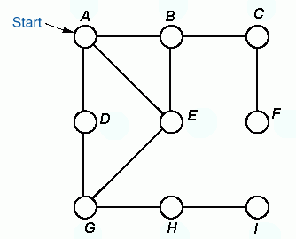

Example of BFS
BFS-tree:
Order of
Traversal
A B D E C G F H I

Slide 40
Complexity analysis of BFS
For a Graph G=(V, E) and n = |V| and m=|E|
When Adjacency List is used
Complexity is O(m + n)
When Adjacency Matrix is used
Complexity is O(n²)

Slide 41
Depth First Search (DFS)
In DFS after visiting a starting vertex v (say), neighbour w of v is visited , then
neighbour x of w is visited that has not been visited before and so on.
When it gets stuck, the DFS backtracks until it finds the first vertex that still has a
neighbour that has not been visited before. It continues with this neighbour until it
has to backtrack again. Eventually, it will visit all vertices reachable from v.
Must keep track of vertices already visited to avoid cycles.
The method can be implemented using stack data structure.
Algorithm DFS(Graph)
Push the starting vertex in the empty stack
while(stack is not empty)
Pop a vertex from the stack, call it v
if v is not already visited, visit it and add v to visited list (DFS order)
Push all the vertices adjacent to v that are not visited earlier.
Note:
Adjacent vertices can be pushed in any order but to obtain a unique traversal, we will push them in reverse alphabetical order.

Slide 42
DFS: Start with Node 5
5
5
2
0
1
3
7
4
6
Push 5

Slide 43
5
2
0
1
3
7
4
6
Pop 5 and visit and mark
Visited list (DFS order)
5

Slide 44
1
2
5
2
0
1
3
7
4
6
Push 2, Push 1
Visited list (DFS order)
5

Slide 45
2
5
2
0
1
3
7
4
6
Pop/Visit/Mark 1
Visited list (DFS order)
5 1

Slide 46
0
2
4
2
5
2
0
1
3
7
4
6
Push 4, Push 2, Push 0
Visited list (DFS order)
5 1

Slide 47
2
4
2
5
2
0
1
3
7
4
6
Pop/Visit/Mark 0
Visited list (DFS order)
5 1 0

Slide 48
3
7
2
4
2
5
2
0
1
3
7
4
6
Push 7, Push 3
Visited list (DFS order)
5 1 0

Slide 49
7
2
4
2
5
2
0
1
3
7
4
6
Pop/Visit/Mark 3
Visited list (DFS order)
5 1 0 3

Slide 50
2
7
2
4
2
5
2
0
1
3
7
4
6
Push 2
Visited list (DFS order)
5 1 0 3

Slide 51
7
2
4
2
5
2
0
1
3
7
4
6
Pop/Mark/Visit 2
Visited list (DFS order)
5 1 0 3 2

Slide 52
2
4
2
5
2
0
1
3
7
4
6
Pop/Mark/Visit 7
Visited list (DFS order)
5 1 0 3 2 7

Slide 53
6
2
4
2
5
2
0
1
3
7
4
6
Push 6
Visited list (DFS order)
5 1 0 3 2 7

Slide 54
2
4
2
5
2
0
1
3
7
4
6
Pop/Mark/Visit 6
Visited list (DFS order)
5 1 0 3 2 7 6

Slide 55
4
2
5
2
0
1
3
7
4
6
Pop 2 (don’t visit))
Visited list (DFS order)
5 1 0 3 2 7 6

Slide 56
DFS: Start with Node 5
2
5
2
0
1
3
7
4
6
Pop/Mark/Visit 4
Visited list (DFS order)
5 1 0 3 2 7 6 4

Slide 57
DFS: Start with Node 5
5
2
0
1
3
7
4
6
Pop 2 (don’t visit)
Visited list (DFS order)
5 1 0 3 2 7 6 4

Slide 58
DFS: Start with Node 5
5
2
0
1
3
7
4
6
Done
Visited list (DFS order)
5 1 0 3 2 7 6 4

Slide 59
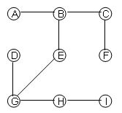
Example of DFS
DFS Tree:
Order of
Traversal
A B C F E G D H I

Slide 60
Important Points –
The BFS and DFS traversal of a graph G is not unique. A traversal depends both on the starting vertex, and on the order of traversing the adjacent vertices of each node.
In an undirected graph, starting from any vertex, we can not visit all vertices if the traversed graph is disconnected.
In a directed graph, starting from a particular vertex, we may not visit all vertices if the traversed graph is weakly connected

Slide 61
Complexity analysis of DFS
For a Graph G=(V, E) and n = |V| and m=|E|
When Adjacency List is used
Complexity is O(m + n)
When Adjacency Matrix is used
Complexity is O(n²)

Slide 62
Spanning Tree
Let G be a weighted graph, then a spanning tree of graph G is another graph G’ with following condition –
Should contain all vertices of G
Should not have any cycle
Should be connected
A graph can have any number of spanning trees
A spanning tree has (N – 1) edges where N is the number of vertices in the given graph.
Minimum Spanning Tree (MST) or minimum cost spanning tree is a spanning tree whose sum of weights on edges is minimum in all spanning tree.
A connected, undirected graph
Four of the spanning trees of the graph

Slide 63
Finding a spanning tree
To find a spanning tree of a graph,
pick an initial node and call it part of the spanning tree
do a search from the initial node:
each time you find a node that is not in the spanning tree, add to the spanning tree both the new node and the edge you followed to get to it
One possible result of a BFS starting from top
One possible result of a DFS starting from top
An undirected graph

Slide 64
Finding minimum cost spanning trees
There are two basic algorithms for finding minimum-cost spanning trees, and both are greedy algorithms –
Kruskal’s algorithm
Prim’s algorithm

Slide 65
Kruskal’s Algorithm
Start with no nodes or edges in the spanning tree, and repeatedly add the cheapest
edge that does not create a cycle
T = empty spanning tree E = set of edges N = number of nodes in graph
Sort all the edges in increasing order of their weights.
While T has less than N - 1 edges
Remove an edge (v, w) of lowest cost from E
if adding edge (v, w) to T creates a cycle
then discard (v, w)
else add (v, w) to T

Slide 66
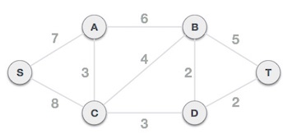

Find MST using Kruskal’s Algorithm

Slide 67
Prim’s Algorithm
Start with any one node in the spanning tree, and repeatedly add the cheapest edge,
and the node it leads to, for which the node is not already in the spanning tree.
T = a spanning tree containing a single node s E = set of edges adjacent to s
While T does not contain all the nodes
Remove an edge (v, w) of lowest cost from E
if w is already in T
then discard edge (v, w)
else
add edge (v, w) and node w to T
add edges adjacent to w to E
Time Complexity O(V^2) If the input graph is represented using adjacency list, then the time complexity of Prim’s algorithm can be reduced to O(E log V) with the help of binary heap

Slide 68
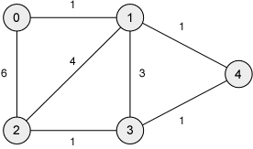
Find MST using Prim’s Algorithm

Slide 69
Applications of graph
Finding communities in networks
Connectivity between cities
GPS to find out shortest path
Represent real time network

